Slide 1
Web Technology Game Idea Presentation
Ajil P Pappachan
L5 GMD

Slide 2
A Crocodile’s Tail
Idea 1

Slide 3
Game Concept
Player controls a crocodile.
The Objective of the player is to eat birds flying overhead.

Slide 4
Game Mechanics
Player can move left and right
Player can jump up
If the jump is timed right, player can reach the bird and eat it.

Slide 5
Game Mechanics
Birds move from left to right of the screen or from right to left.
The number of birds and speed increase over time.

Slide 6
Game Mechanics
Game ends when the player misses three birds.
High score is calculated based on the number of birds eaten.

Slide 7

Game Art
Crocodile

Slide 8

Game Art
Bird

Slide 9
The Shapening
Idea 2

Slide 10
Game Concept
Player controls a circle.
The Objective of the player is to avoid being in a killzone.

Slide 11
Game Mechanics
Player can move left and right between three designated zones
Each zone is outlined by a rectangle shape
Zones gets filled up randomly. When a zone is completely filled by a rectangle, the zone becomes a killzone

Slide 12
Game Mechanics
Game ends if the player is in a killzone
Score is calculated based on survival time

Slide 13
Game Art
Player Circle

Slide 14
Game Art
Zones

Slide 15
Game Art
Zones filling

Slide 16
Game Art
Killzone

Slide 17
Game Art
Game Screen Sample

Slide 18
Static Pacman
Idea 3

Slide 19
Game Concept
The concept is similar to that of the original Pacman
The key difference is the addition of turn based gameplay

Slide 20
Game Mechanics
The objective of the player is to collect fruits, avoid ghosts and survive.
The player decides where to move pacman in four degrees of motion.

Slide 21
Game Mechanics
After the player makes his move, the ghosts move one position.
Based on the position of the ghosts and the availability of fruits, the player has to strategically move Pacman.

Slide 22
Game Mechanics
The Game ends when Pacman is killed by a ghost.

Slide 23

Game Art
Pacman

Slide 24




Game Art
Ghosts

Slide 25
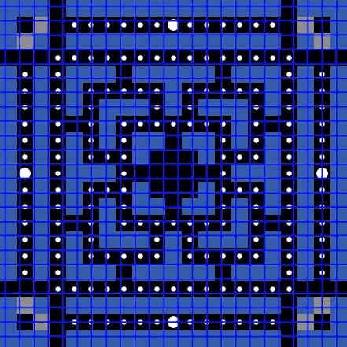
Game Art
Level Prototype

Slide 26
Thank You

